Slide 1

Employee Management System
Shree Vidyadhiraj Polytechnic, Kumta
Presented By
Guided By
Sounjna Bhat
Deepti Gonsalvis Nishmita Madival Deeksha Naik
Mr. Dinesh Balgi
Submitted for the partial fulfillment of Diploma in ComputerScience and Engineering

Slide 2
Content
Problem Statement
Objectives
Description
Deliverables
Key Milestones
Constraints
Work Breakdown Structure
E-R Diagram
Time-line Schedule
Cost Breakdown Structure
Risk Analysis
Identification of Methodology
Employee Management System
2

Slide 3
Problem Statement
Develop an Employee Database Management System that efficiently organizes and manages employee information, including personal details, job roles, qualification, dependents’ details, nominee details, leave management and salary slip generation. The system should prioritize data security, user accessibility, and streamline administrative tasks to enhance overall workforce management.
Employee Management System
3

Slide 4
2)Objectives
Efficient Data Organization: Ensure systematic storage and retrieval of employee information, including personal details, job roles, qualification, dependents’ details and nominee details.
Streamlined Record Keeping: Facilitate easy maintenance and update of employee records, reducing manual paperwork and enhancing accuracy.
Improved Accessibility: Enable authorized personnel to access relevant employee data promptly, fostering quick decision-making and efficient human resource management.
Enhanced Security Measures: Implement robust security protocols to safeguard sensitive employee information and maintain compliance with data protection regulations.
Automated Processes: Integrate automation for routine administrative tasks such as leave management, and salary slip generation, reducing manual workload.
Employee Management System
4

Slide 5
3)Description
The Employee Database Management System (EDBMS) is a comprehensive software solution designed to efficiently handle various aspects of employee information within an organization such as college. This project aims enhance data accuracy, and provide valuable insights for effective decision-making.
Employee Management System
5

Slide 6
4)Deliverables
Database Design and Schema:Includes the Entity-Relationship Diagram (ERD) and data schema defining the structure of the employee database.
User Interface (UI) Design:Mockups or wireframes illustrating the visual representation of the system, ensuring a user-friendly interface.
Backend Development Code:Source code for the backend, encompassing database interactions, business logic, and security features.
Authentication and Authorization Setup:Implementation of secure login mechanisms and role-based access control to safeguard data integrity.
Testing Documentation:Test plans, test cases, and test results to ensure the system's functionality, security, and reliability meet requirements.
Employee Management System
6

Slide 7
5)Key Milestones
Requirements Definition
Database Design and Schema Finalization
Development and Integration
Security Implementation
Testing and Quality Assurance
Employee Management System
7

Slide 8
6)Constraints
Data Privacy and Compliance
Security Measures
Integration Challenges
Resource Limitations
Legacy Systems and Data Migration
Employee Management System
8

Slide 9
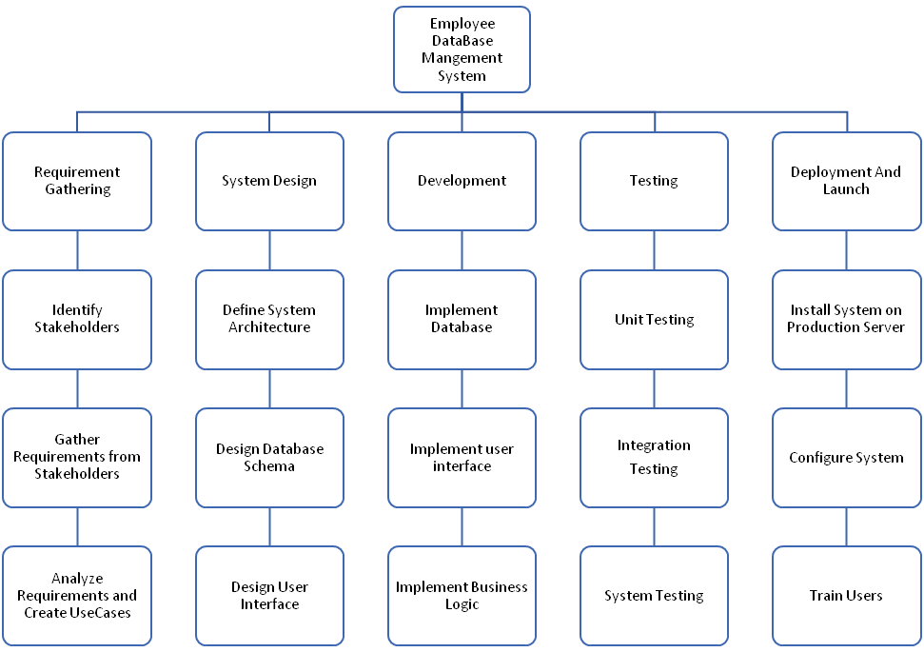
7)Work Breakdown Structure
Employee Management System
9

Slide 10
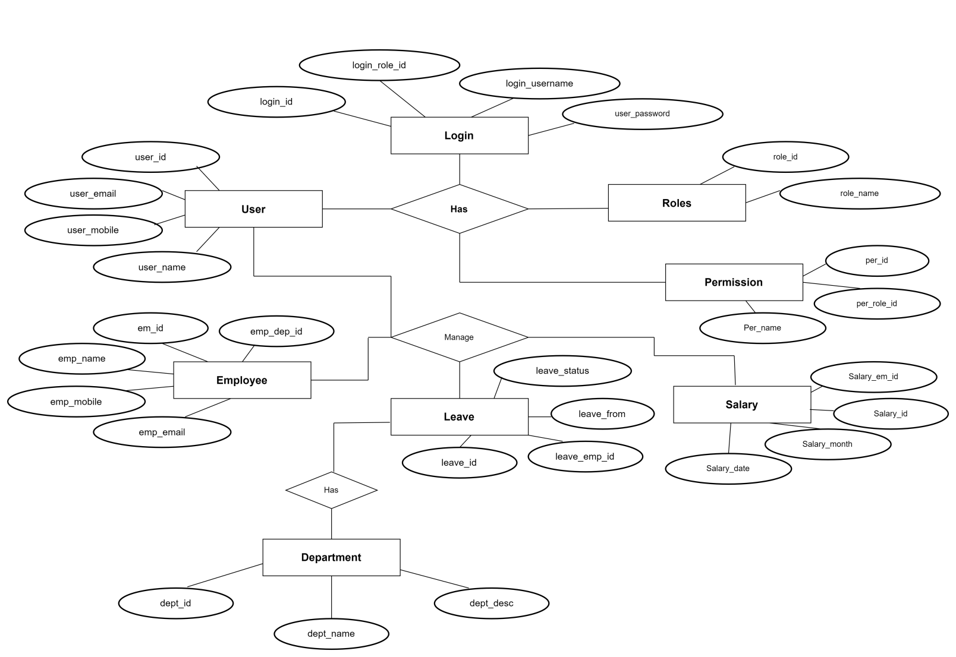
8)E-R Diagram
Employee Management System
10

Slide 11
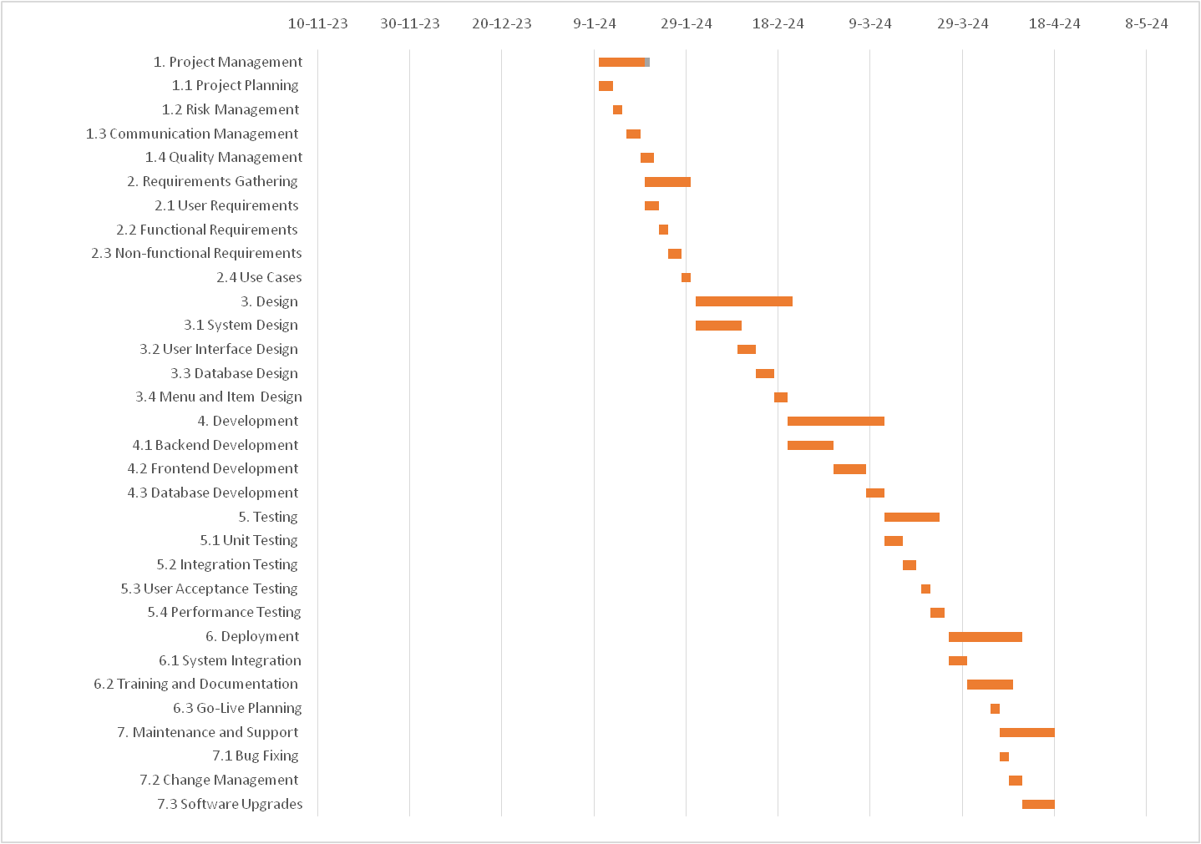
9)Time-Line Schedule
Employee Management System
11

Slide 12
10)Cost Breakdown Structure
Total Developers: 3
Total Duration: 4 months
Total Labour Cost: ₹69,000
Estimated Cost Of Material: ₹16,000
Contingency Amount: ₹7,000
Final Check:
Subtotal = Labour Cost+Material Cost+Contingency Amount
= 69,000+16,000+7,000
= ₹92,000
Employee Management System
12

Slide 13
11)Risk Analysis
Technical Risks:
Compatibility Issues: The employee management system may have compatibility issues
With different browsers or operating systems,which can result in customer dissatisfaction
and decreased revenue.
Security Risks: The employee management system may be susceptible to hacking attacks
Or data breaches, resulting in the loss of confidential customer information.
Schedule Risks:
Delay in Development: The development team may face delays in delivering the project,
resulting in missed deadlines and potential loss of revenue.
Delay in Launch: The launch of the employee management system may be delayed due to
technical issues or changes in requirements, resulting in customer dissatisfaction and
decreased revenue.
Cost Risks:
Over Budget: The development costs of the employee management system may exceed
the budget, resulting in financial losses for the Company.
Unexpected Expenses: The online food delivery system may incur unexpected expenses,
such as server maintenance or license fees, resulting in increased costs and
reduced profits.
Employee Management System
13

Slide 14
11)Risk Analysis
Organizational Risks:
Lack of Communication: Poor communication between team members can lead to misaligned objectives, missed deadlines, and increased Costs.
Changes in Stakeholders: Changes in stakeholders can lead to changes in requirements or project goals, resulting in increased costs and delayed timelines.
People Risks:
Skill Shortage: The development team may lack the required skills to complete the project, resulting in increased costs and missed deadlines.
Employee Turnover: Key team members may leave the project, resulting in reduced productivity and increased costs.
Requirements Risks:
Changes in Requirements: Changes in requirements can lead to increased development costs, missed deadlines, and a decrease in customer satisfaction.
Unclear Requirements: Unclear or incomplete requirements can lead to misaligned objectives, increased development costs, and a decrease in customer satisfaction.
Business Risks:
Competition: The employee management system may face stiff competition from established players in the market, resulting in decreased market share and revenue.
Regulatory Changes: Changes in government regulations can affect the operations of the employee management system, resulting in increased costs and decreased revenue.
Employee Management System
14

Slide 15
12)Identification Of Methodology
Agile methodology is an iterative and incremental project management approach that is widely used for software development projects. The agile methodology involves breaking
down the project into small and manageable parts, known as sprints. Each sprint has a
defined duration and is focused on delivering a specific set of features. The agile methodology used for the employee management system project involved the following steps:
Sprint Planning:
The first step in the agile methodology was to plan the sprint. A sprint is a fixed duration of time during which a set of features is developed. The sprint planning involved identifying the features to be developed during the sprint, defining the scope, and estimating the effort required to complete the features.
Sprint Execution: The second step in the agile methodology was to execute the sprint. The sprint execution involved developing the features identified during the sprint planning. The development was done using the spring boot, react and mysql.
Daily Stand-Up Meetings: The third step in the agile methodology was to hold daily stand-up meetings. These meetings were used to discuss the progress made during the print, identify any roadblocks, and plan the tasks for the next day. The daily stand-up meetings ensured that the development team was on track and any issues could be addressed promptly.
Employee Management System
15

Slide 16
12)Identification Of Methodology
Sprint Review:
The fourth step in the agile methodology was to conduct a sprint review. The sprint review involved reviewing the features developed during the sprint and seeking feedback from stakeholders. The feedback obtained during the sprint review was used to refine the features developed during the sprint and ensure that the project was on track.
Sprint Retrospective: The final step in the agile methodology was to conduct a sprint retrospective. The sprint
retrospective involved reflecting on the sprint and identifying areas for improvement. The
feedback obtained during the sprint retrospective was used to improve the development
process for the next sprint.
Employee Management System
16

Slide 17
12)Identification Of Methodology
Advantages of Agile Methodology: The use of agile methodology for the Employee Management System project provided
several advantages. These advantages include:
Flexibility: The agile methodology allowed the development team to be flexible and adapt
to changes during the development process.
Collaboration: The daily stand-up meetings and sprint review allowed for better collaboration between the development team and Stakeholders.
Faster Time-to-Market: The iterative and incremental development approach enabled the development team to deliver features faster, resulting in a faster time-to-market.
Continuous Improvement: The sprint retrospective allowed for continuous improvement of the development process, resulting in a more efficient and effective development process.
Employee Management System
17

Slide 18
Thank You

